Slide 2
DISCLAIMER
Not really any for this specific meeting, but in general: Do not hack stuff you do not own or do not have authorized (preferably written) permission to do so. The existence of a vulnerability is not an invitation!

Slide 3
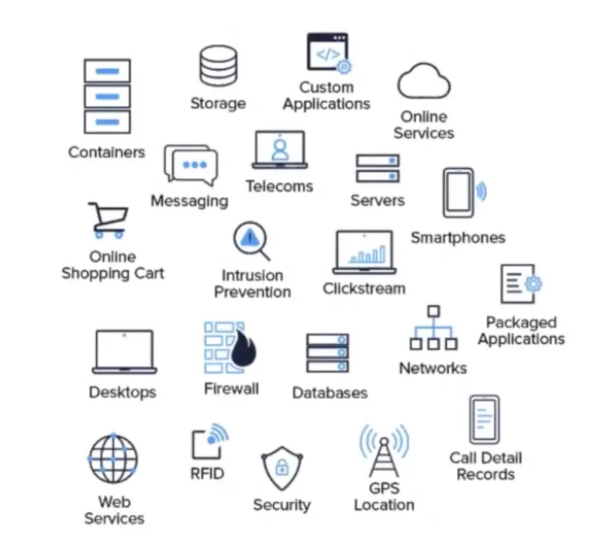
What is a Log file?
Logs files are essentially historical records of events that occur on some program, operating system, etc.
Logging (the action of making/keeping logs) is done by nearly everything, i.e. you can have a log file for nearly anything. Some examples are…
Web server connections
Log-in attempts
Messages between users
And many more
Log files for our purposes are any logs automatically generated in some form, and not hand created logs.
For Linux systems, most logs can be found in /var/log
For Windows systems, you can use the event viewer

Slide 4
Why do we log? (and Importance of Analysis)
Logs are not actually just for security reasons! Sometimes a program might crash out of nowhere, or a service may have stopped, and you will have to look at logs to deduce why this happened
But Logs are also used for security purposes. Maybe you want to log all the login times that an account made, so if any suspicious activity happens you can go back and look at the logs.
Logs are used in many fields as well beyond computer science but can be important for conducting legal investigations. Maybe someone claimed to be at a store at a time. Does a log file back them up or maybe, does a log file contradict them?

Slide 5
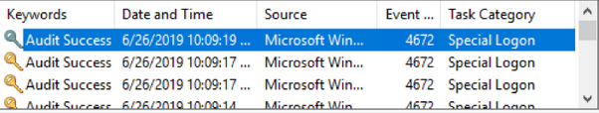


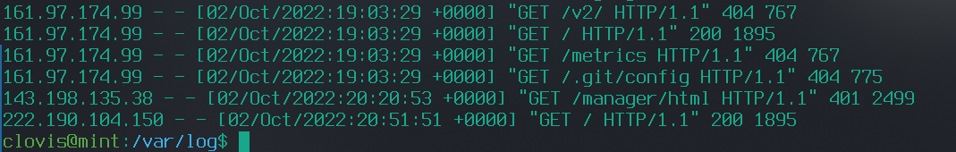
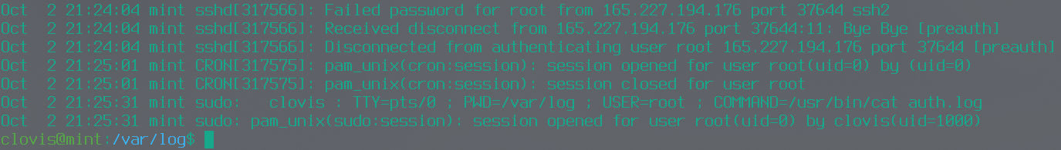
Log File Anatomy
Look at the following log files and notice the similarities and differences in them

Slide 6
Log File Anatomy
As you saw, Log files can be very different! They can be stored in text files, databases, or even custom ways. They can also be stored in plain text, binary, or encrypted.
The “general” anatomy of a log file is as follows
Timestamp: Usually the exact time the event has occurred (At 7pm…
User/Source info: Who/what generated the log (...The user “Fake User”…)
Even information: What happened? (...Downloaded file “/etc/shadow”)
Although this may not be the case for some very unique log files, the general log file you will encounter will contain this information!
Logs will also generally have rows and columns.
Each row is a new entry into the log
Each column is a different piece of information. For example, a log file could have the first column is an IP address, the second column is a time.

Slide 7
More Examples of Log File Types
From “https://www.crowdstrike.com/cybersecurity-101/observability/log-file/”
Event Log: a high-level log that records information about network traffic and usage, such as login attempts, failed password attempts, and application events.
Server Log: a text document containing a record of activities related to a specific server in a specific period of time.
System Log (syslog): a record of operating system events. It includes startup messages, system changes, unexpected shutdowns, errors and warnings, and other important processes. Windows, Linux, and macOS all generate syslogs.
Authorization Logs and Access Logs: include a list of people or bots accessing certain applications or files.
Change Logs: include a chronological list of changes made to an application or file.
Availability Logs: track system performance, uptime, and availability.
Resource Logs: provide information about connectivity issues and capacity limits.
Threat Logs: contain information about system, file, or application traffic that matches a predefined security profile within a firewall.

Slide 8
Some important things about logs
It is important to note that some logs may only keep a limited amount of information in order to preserve space.
This may be important as if there has been a hack, you may need to make sure you get the log files as fast as possible.
They can be (but very hard to in some cases) modified.
A common things hackers will do is delete log files in order to hide things that they have done. Another things is they may purposefully fake log file entries in an attempt of “anti-forensics”. Some ways of countering this is storing logs on an external server known as a log server.
When I say everything is logged, I quite literally mean it! This is actually what makes hacking for hackers so hard nowadays as a single mistake can ruin an attackers whole operation .
For example, the FBI were tracking a hacker group for a long time, and were able to get an http log from a login attempt of one of the attackers who accidentally used their normal username and not their attacker username…

Slide 9
Parsing Logs
If I went into the many niche tools used to parse logs, I would be here forever! Personally 99% of the logs that I have analyzed I have been doing with just a linux terminal and no fancy program (the 1% was a random graphql log on neo4j for a ctf)! If you choose to use a program, make sure you do research on it. (sometimes logs are custom too and you actually will never be able to find a log analyzer for it and are forced to do it by hand!)
For today I will be focusing on using linux command line tools to parse logs, which is still an important skill to do.
For example, if you can only connect to a server remotely that has been attacked, and it doesn’t have a gui, you dont really have an option to download some fancy gui log viewer.
If you are someone trying to cover your tracks, downloading a fancy program to delete your logs (which generates more logs and takes more time) probably is not the ideal way to go.

Slide 10
Parsing Logs Continued
The other two methods for parsing logs outside of specific tools are:
Writing scripts/programs in your favorite language (like Python)
Using the linux terminal
It can be useful to write your own scripts or programs especially if you will see the log file type often, as it can save time and energy, and it is also a great way to practice coding! However, failure to make it correctly can lead to missed data, as well as if you only have the log file one time, it could be a waste of time.
For using your linux terminal, you can do so many crazy things that you you can actually do with your terminal for log analysis. We will go over a lot of linux commands, there is no need to memorize them, but you will see as you continue your journey in Cyber or even CS, that these commands will be helpful in day to day activities.
Before we get into the commands and practice, let's talk about the general approach to log analysis.

Slide 11
Log File Analysis!
The first thing is to figure out what log file you may need to look at. If you already have this, you can skip this.
Usually you can check places like “/var/log/<program name>/<log>.log” for logs but they could be stored anywhere, so do research on where the logs for the specific program are.
Think of every single program or process that could have been affected. For example, if an attacker stole files from a database, log files for mysql are not the only file you want to look at! Maybe check auth logs to see if they logged into the server. Maybe they did sql injection on your website so you will have to check those logs. Maybe the firewall logs have info. (Do you see what I mean when I say that everything has logs?). And so many other places. Think outside the box and like the attacker!

Slide 12
Log File Analysis!
Next thing is to understand the logs. If this is a common log file type feel free to google it.
However if this is encrypted you may need to search online for encryption techniques. Maybe it isnt encrypted but encoded (meaning where instead of something being true or false in a file, it is actually a single bit of binary. This is a pain to deal with and will take heavy analysis of each entry, see whats different, and a lot of educated guessing. This is out of scope for this, but I had to do this for a ctf before D: [and found out that it was a standard encoding scheme anyway oops. Scheme was “Protobuf”])
If its a custom log, or one with no documentation, see if you can use the anatomy of logs to your advantage!
For example, do any of the columns look like it could be a date? Is there a specific separation? If you are looking at binary data try starting at the ends and working in to separate data into columns.

Slide 13
Log File Analysis!
Next step is to break your problem down into smaller chunks by asking yourself questions. Some examples and how you would break it down.
What exactly are you looking for?
If you are looking for logs made by a specific person, maybe only show logs by that person. If the logs are more of a time period, split it by time period. Maybe logs by a certain ip address? You get the idea.
Note: Always think about how you could be missing info. If you want logs by a specific user for example, and you use their ip. What if they used a vpn? In this case a username would be better.
What is the appropriate time period?
Can I get rid of ______ entries, or are they important.
Am I considering all cases?
Could there be a specific set of words I could look for.
If someone did an sql injection maybe searching for “sqlmap” or “1=1” could help find useful information for example.

Slide 14
Log File Analysis!
After you found the information you wanted to find, the last stage is to either synthesis it with other information, or use it on its own.
Maybe the log entries are good on their own such as quite literally saying “User X downloaded confidential information Y” and in that case, the case is closed.
However, maybe you will need to put what you find in multiple log files together to form a narrative. You may also need to use multiple log files to even make a point, as each one on their own could look like some normal activity like a hacker was trying to do.
Besides all this, Log analysis is Really a lot about problem solving. You will have to think of what you can do to properly get the information you want. Thankfully NCL has problems like “How many get requests did user x make” But unfortunately harder problems or real life may not be that simple.

Slide 15
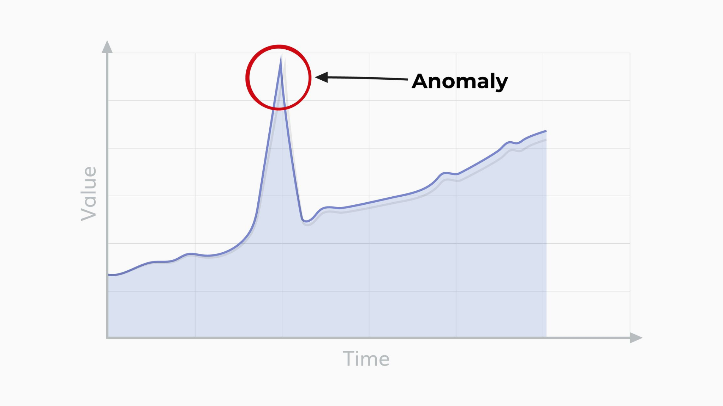
Log File Analysis!
Last but not least before we talk about the actually techniques of parsing…
Anomaly Detection!
An anomaly is something that “is out of the ordinary”.
Anomalies may be really hard to spot on first glance, especially when dealing with text based logs, but can be the only thing that will help you solve a problem.
Anomalies though have an issue of possibly being a false positive, where even though it is out of the ordinary its due to some issue.
An example of an anomaly is seeing that there was an increase in network usage from a specific user, or that ports that usually aren't touched, suddenly get a lot of interaction.

Slide 16
Linux commands for Log Parsing
We are finally here! Now there are many linux commands that you could use and people may debate with others on what you use for what, but at the end of the day you really use what you have! I recommend getting some linux cheat sheet with commands like these, so you can reference it. I have linked one here, but feel free to search for one that works for you. https://www.loggly.com/wp-content/uploads/2015/05/Linux-Cheat-Sheet-Sponsored-By-Loggly.pdf
On the next slide I will list some common ones. These should not edit files (unless you say so as an option) and just print the result to the screen.

Slide 17
Linux commands for Log Parsing
man – by doing “man <command>” you will find more information on a command. Sometimes you can do “<command> --help” aswell. putting this here as many of these commands have specific options you can select to do specific things, and that would take too much time to go over.
cat/strings – Both of these commands can output a file to the terminal.
grep – You can use this to search for strings or things inside of a file and only show that.
-i – this option will make search not case sensitive
-v – this option will do the opposite and show lines without search
<cmd1>|<cmd2> – not a command but this is known as a pipe aka probably the most important thing ever (not really but you will use it a lot). You use this to chain commands together, where one commands output will go into another. An example of this can be “cat access.log | grep ‘root’” which will look for any line with root in access.log and show that. You can also chain these, which you will do. Parsing can get you some long chains. For the following commands ill show you how to use them on a specific file, but you can also pipe the data in.

Slide 18
Linux commands for Log Parsing
cut – You can use this to display only certain columns or characters
-d – delimiter. Maybe the file is comma separated so you would specify that. For commas “cut -d, file.log”. Default is tabs
-f – field. Using the delimiter what fields/columns, shows the fields/columns that you indicate. For column 1 and 2, “cut -f1-2 file.log”
awk – this is more of an advanced tool for analyzing with its own “language” in a way, but when learned can be great. Usually you can use this to print certain columns, for example columns 1,4,5 would be “awk ‘{print $1 $4 $5}’ file.log”
uniq – removes any duplicated lines that are next to each other! “uniq file.log” if you want to remove all duplicates, use “sort” first.
-c – also prints the amount of times each line appears
sort – sorts the file according to something. Default is the alphanumerically, but things like dates can also be sorted with some options. Note: use -n if its numerical, as it will only look at the first number in the number (like 1 in 1242) and sort by that. “sort file.log”

Slide 19
Linux commands for Log Parsing
wc – “word count” you can use this to count the number of lines, character, etc. an example is “wc file.log” (format for most of the commands here haha)
<cmd1> >> <output file> OR <cmd1> > <output file>– sorry for the confusing formats, but “>>” and “>” can put output in a file.
“>” will make a new file or overwrite an existing file
“>>” will make a new file or append to an existing file
head – this command will show the first 10 lines by default of a file.
-c – show the first X Bytes/characters of a file
-n – show the first X lines of a file
tail – does what “head” does but for the end of a file
-f – by using -f you can actually see live updates to the end of a file.
These are nowhere near all the commands, but just some common ones. Feel free to google around for more commands. Even googling how to do things can help. For example “how to add all the numbers in one column in bash” can get you a command chain to do. Make sure you can generally understand what commands do from other people before running them.

Slide 20
Time for a walk through of some log analyzing, and how you can practice this yourself!

